Slide 1
HTML - introduction
Viktoras Lava www.viktoraslava.lt

Slide 2
What is HTML?
HTML is a language for describing web pages and web applications
HTML stands for Hyper Text Markup Language
The purpose of the tags are to describe page content. Tag ex. is on the right ->
HTML is not a programming language, it is a markup language
<html>
</html>

Slide 3
Tags
HTML tags are surrounded by angle brackets like <html>
HTML tags normally come in pairs like <body> and </body>
The first tag in a pair is the start tag, the second tag is the end tag
<body>
Hello world!
</body>

Slide 4
Main tags
The text between <html> and </html> describes the web page
The text between <head> and </head> is the unvisible page content or meta information
The text between <body> and </body> is the visible page content
The text between <h1> and </h1> is displayed as a heading
The text between <p> and </p> is displayed as a paragraph
The text between <a> and </a> is displayed as a link

Slide 5
Starting page
<!DOCTYPE html>
<html>
<head>
<meta charset="utf-8">
<title></title>
</head>
<body>
Visible content
</body>
</html>
How does the starting page of the HTML look like?

Slide 6
Questions?

Slide 7
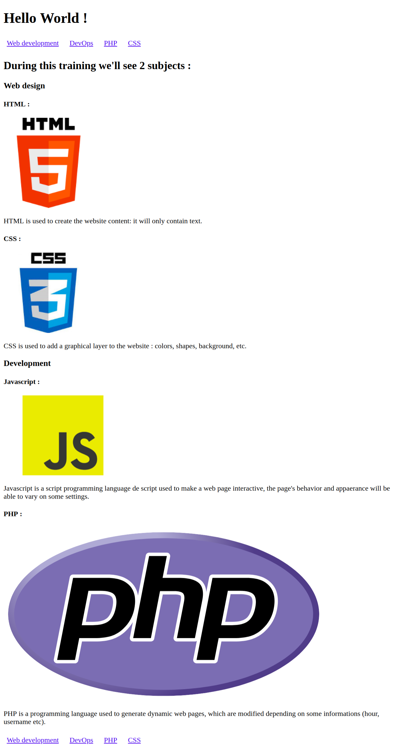
Homework
Play around with the Atom’s text editor
Try the Chrome’s inspect mode (try to inspect the HTML code of http://google.com or other your favourite website)
Do the homework task

